Slide 1
Car Price Prediction
- Harshil Goradia

Slide 2
Business Problems:
With the covid 19 impact in the market, we have seen lot of changes in the car market.
Now some cars are in demand hence making them costly and some are not in demand hence cheaper.
The motive for taking down this project is to know the car price demand for used cars and use machine learning models to make predictions of the new trend

Slide 3
Data Processing:
I extracted the data from olx.com using web scraping techniques and converted to into dataframe for further process. I scraped brand, fuel type, number of owners, transmission, location, variant, kilometer travelled and price of the car.
For cleaning the data, null values were replaced by mode value of each column assuming that replacing them won’t affect the model.
Splitted Model and Variant columns into Brand and car name for better understanding and analysis.
Converted Price and Kilometer column into integer data type from categorical data type.
Later Encoded categorical columns using Label Encoder before scaling the dataset using MinMaxScaler.
After scaling, the dataset was ready for splitting into training and testing dataset for machine learning.

Slide 4
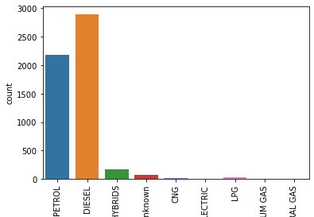
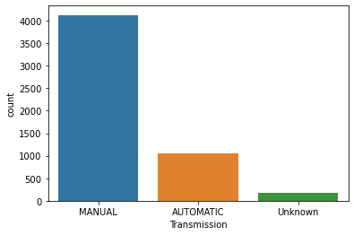
There are around 3000 diesel cars and more than 2000 petrol cars placing them 1st and 2nd respectively. Least are cng cars with petrol, only cng, lpg cars with petrol. 2. Most of the cars have manual transmission that is more 4000 cars. There are only 1000 cars with automatic and only 200 are unknown.

Slide 5
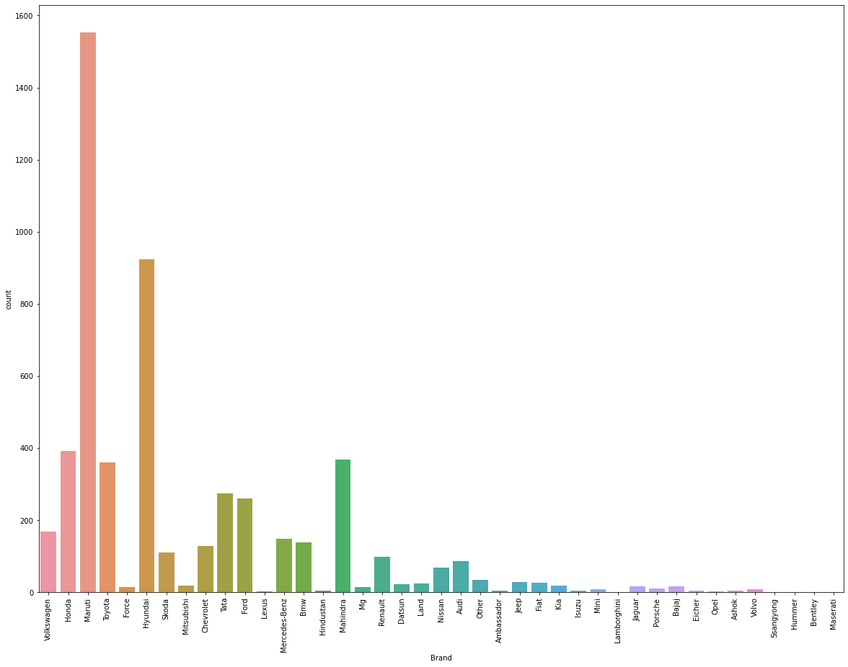
Maruti brand is the brand with highest number of cars which are to be re-sold.
Hyundai has nearly 1000 used cars to be sold, making it second highest brand for re-selling of cars.
Mahindra is placed third along with Honda and Toyota.
Opel, Jaguar, Bentley, Volvo, Mini, Porsche, Bajaj, Hummer, Masserati, Isuzu are some of the brands who’s very few cars are to be re-sold.

Slide 6
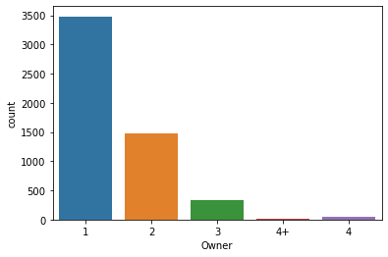
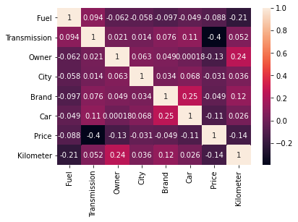
1. There are no independent columns co-related with each others. 2. There are less than 100 4 or 4+ car owners who are selling their car. 3. Highest number of cars that are to be sold are by 1st owners followed by 2nd owner with 1500 cars. 4. Less than 500 cars who are 3rd owner of cars are willing to sell their car.

Slide 7
Resources Used:
Jupyter Notebook - The whole project was done in jupyter notebook which provides python environment.
Selenium – Selenium was used for web scarping to extra data from olx.com. This data was later used for analysis.
Pandas and Numpy - These libraries which are most important for an predictive analysis project. These libraries provide a function of shaping the data, importing the data and viewing the data.
Matplotlib and Seaborn – These libraries were used for visualising the data in the entire project. All the visualization done in the project were done using either one of these libraries.
Sklearn – This library was the most used library as compared to other libraries. This library has been used in pre-processing for imputing numerical null values and for scaling the dataset. Later it was widely used for importing algorithms for machine learning and predicting.

Slide 8
Steps:
Web Scraping using selenium.
Data Processing – Data importing, Data visualization, Data pre-processing, Machine Learning.
Imported data which was extracted by web scraping.
Used visualization tools to understand the data better.
Data pre-processing i.e. LabelEncoding and MinMaxScaler, were used for preparing the dataset for Machine Learning.
Machine Learning Algorithms were used to predict the best model for car prices.
Hyper Parameter Tuning was done to find the best parameters for some algorithms.

Slide 9
Algorithms Used:
LinearRegression
RandomForestRegressor
DecisionTreeRegressor
SVR
GradientBoostingRegressor
AdaBoostRegressor

Slide 10
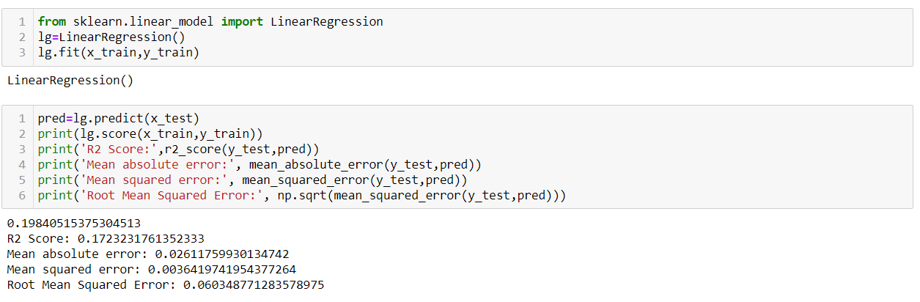
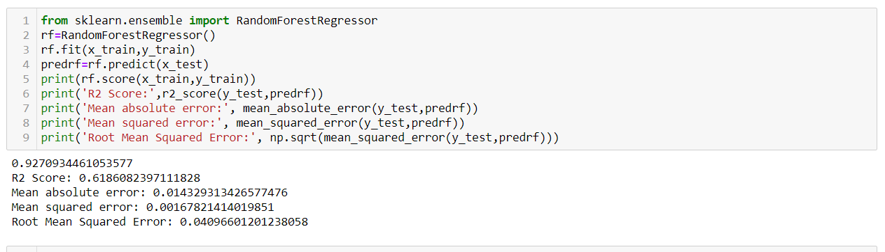
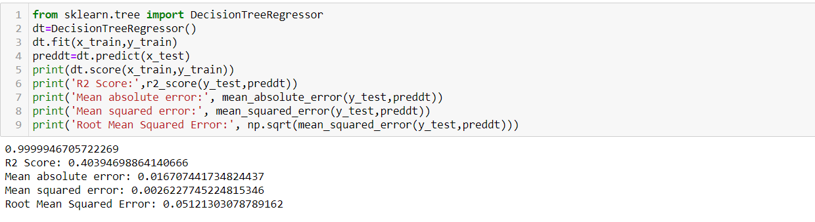
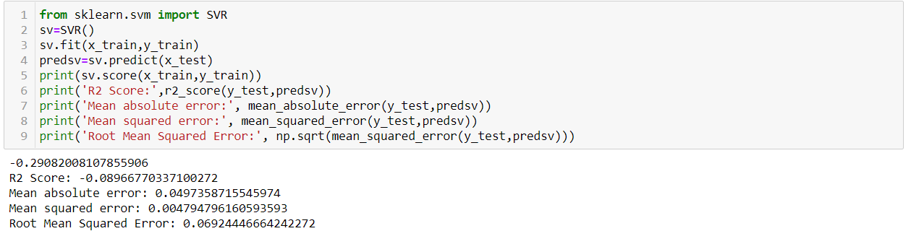
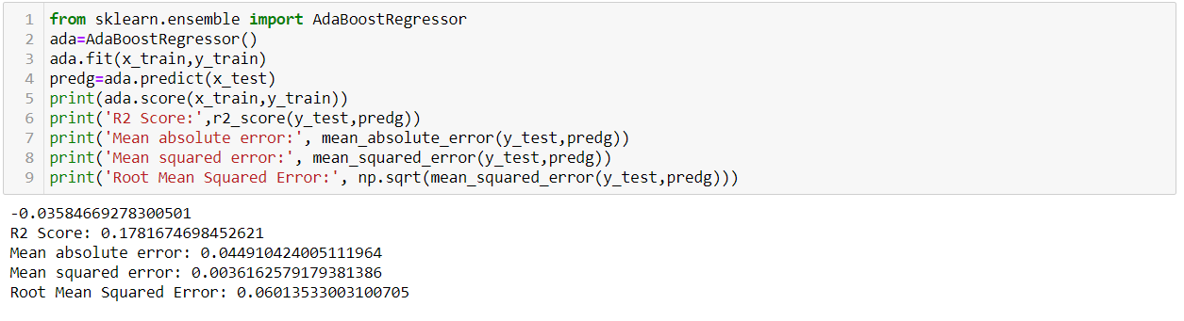
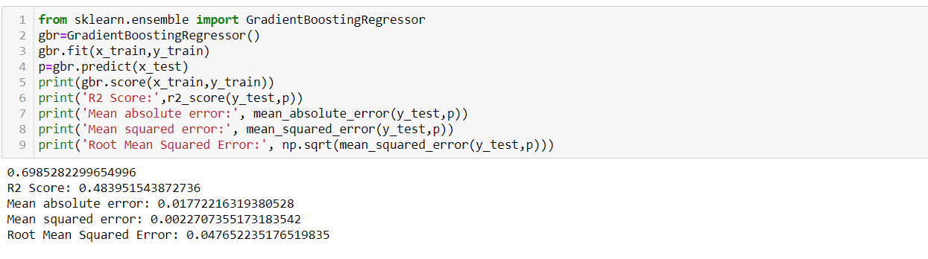

Slide 11
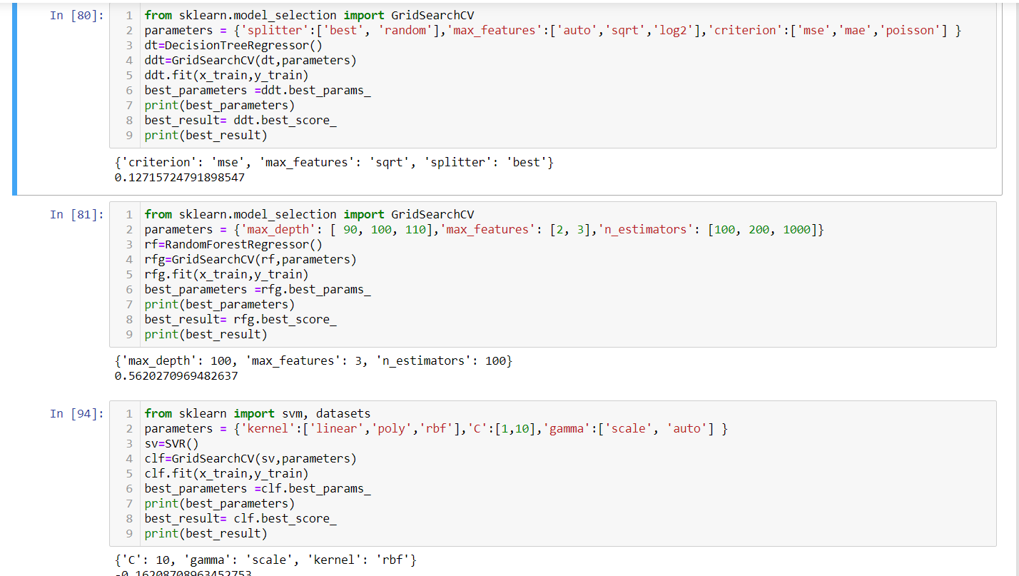

Slide 12
Conclusion And Limitations:
After visualizing I found that there is no co-relation between different variables. Post modelling, I interpreted that RandomForestRegressor was the best performing model.
Visualization helped to conclude that most of the cars that are to be sold are of Maruti’s. Most the car sellers are 1st owners, and the cars are mostly diesel cars or petrol cars. The best model for predicting the price was RandomForestRegressor with parameters (max_depth = 100, max_features = 3, n_estimators = 100).
The data used for this project is collected from few states only out of 29 states of India. So, the model built can only help predict prices from these states, this model cannot predict prices for all over India.

